Slide 1

Uncover Rubik’s Cube
Team 2
Gao, Yuan
Sivakumar, Shanthakumar
Yang, Xinyu
Zheng, Yuchen
Chenchula Nandan, Chandana

Slide 2

Overview of the project
The primary goal of this project is to provide a user-friendly and intuitive web interface that guides users through the process of solving a 3x3 Rubik's Cube step by step.
The interface will leverage the power of Three.js for 3D cube visualization, React for dynamic web components, and Python for solving algorithms.

Slide 3

Scope
The scope encompasses the development of a web-based application that simulates and solves Rubik's Cubes. With interactive 3D Rubik's Cube simulations, Rubik's Cube solving algorithms, user account management, a hint system, and easy user interface.

Slide 4

Target Users
Beginners: Individuals who are new to solving the Rubik's Cube and want to learn the basics and build their solving skills from scratch.
Intermediate Solvers: Users who have some experience with solving the cube but want to improve their techniques and speed.
Advanced Solvers: Experienced cubers who are looking for advanced algorithms and strategies to enhance their problem-solving skills.
Educators: Teachers and educators who want to incorporate Rubik's Cube solving into their educational programs or use the interface as a teaching tool.
Parents and Guardians: Adults who want to teach their children how to solve the Rubik's Cube or use it as an educational and recreational activity.
Competitors: Individuals participating in Rubik's Cube competitions who use the interface for practice and improvement.
Casual Users: People who simply enjoy playing with the Rubik's Cube for fun and relaxation.

Slide 5
Benefits
Community Building: The interface can foster a community of Rubik's Cube enthusiasts who can share their progress, compete, and collaborate in solving the cube.
Enhanced Problem-Solving Skills: Users can develop and enhance their critical thinking, problem-solving, and algorithmic thinking skills while working on solving the Rubik's Cube.
Engagement: The combination of 3D visualization, interactivity, and user-friendly design makes learning and practicing solving techniques engaging and enjoyable.
Educational Value: It serves as an educational resource for both beginners and experienced cubers, promoting the learning and mastery of Rubik's Cube solving.
Algorithmic Solver: The inclusion of a Python-based solver assists users by providing optimal solutions for scrambled cubes, enhancing their problem-solving skills.
Practice and Improvement: Users can generate random cube scrambles and track their progress, allowing for continuous practice and improvement.

Slide 6
The team, roles and responsibilities
Role | Team Member | Responsibilities
UI Designer | Yuan Gao, Chandana Nandan | Creating visually appealing icons and graphics, Collaborating on UI design, and ensuring a cohesive user experience.
Backend Developer | Yuchen Zheng | Implementing the Rubik's Cube solving algorithm, setting up the backend server, and deployment.
Frontend Developer | Xinyu Yang | Building the frontend interface using React.js, implementing the 3D Rubik's Cube simulation with Three.js, and creating interactive features like hints, random scrambles, and resets.
Project Manager and SQA | Shanthakumar Sivakumar | Overseeing project progress, coordinating tasks, ensuring timelines are met, and resolving project-related issues. Testing the application, identifying bugs, and ensuring a smooth user experience.
Content Writer | Chandana Nandan | Creating, maintaining, and organizing project documentation, including requirements, technical materials, user guides, and meeting minutes

Slide 7

High-Level Project Requirements (Functional requirements)
Interactive 3D Rubik's Cube Simulation –
● The application will provide users with a 3D Rubik's Cube that accurately simulates real-world cube movements.
● Users should be able to rotate the cube in all directions, scramble it, reset it to the solved state, and interact with it seamlessly.
Rubik's Cube Solving Algorithm –
● The application will implement Rubik's Cube solving algorithms, allowing users to input cube configurations and receive step-by-step solutions.
● The solving algorithm will be efficient and provide optimal solutions for various cube states.
User Account Management –
● Users can create accounts, log in, and manage their profiles. User accounts will store progress, achievements, and user-specific data.
● Passwords will be securely stored and authenticated.
Hint System –
● The hint system will provide users with hints and guidance for solving Rubik's Cubes at different skill levels.
● Users can access hints for specific cube states and receive step-by-step instructions.

Slide 8
Non-Functional requirements
Performance Efficiency (Responsiveness) - The application will ensure high performance and responsiveness. This includes minimizing load times for 3D cube simulations, Rubik's Cube solving algorithms, and all user interactions. Users will experience seamless and quick responses to their inputs, enhancing their overall experience.
Scalability - The system will be designed to handle increasing numbers of users and concurrent interactions without significant performance degradation. As more users engage with the application, we continue to provide a consistent and responsive experience.
Data Security - login credentials and profile information will be stored, and transmitted securely. Password encryption and secure communication protocols will be implemented to protect sensitive user data from unauthorized access.
Password Security - Passwords will be securely managed. This involves hashing passwords before storage to ensure that even in the event of a data breach, plain-text passwords cannot be exposed.
Threat Protection - The application is fortified against common web security threats, such as SQL injection, and cross-site scripting (XSS). Regular security audits and assessments will be conducted to identify and mitigate vulnerabilities.

Slide 9
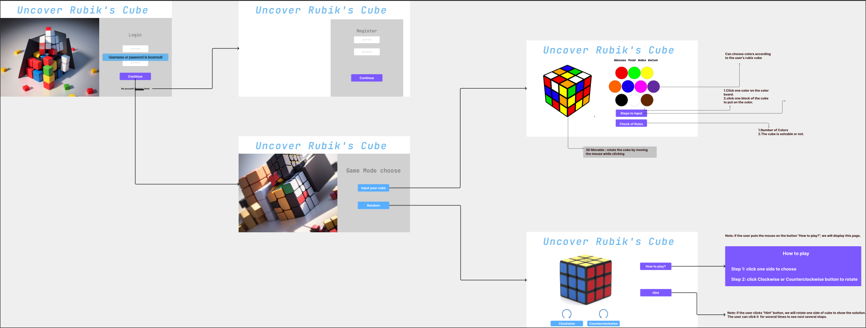
The GUI

Slide 10
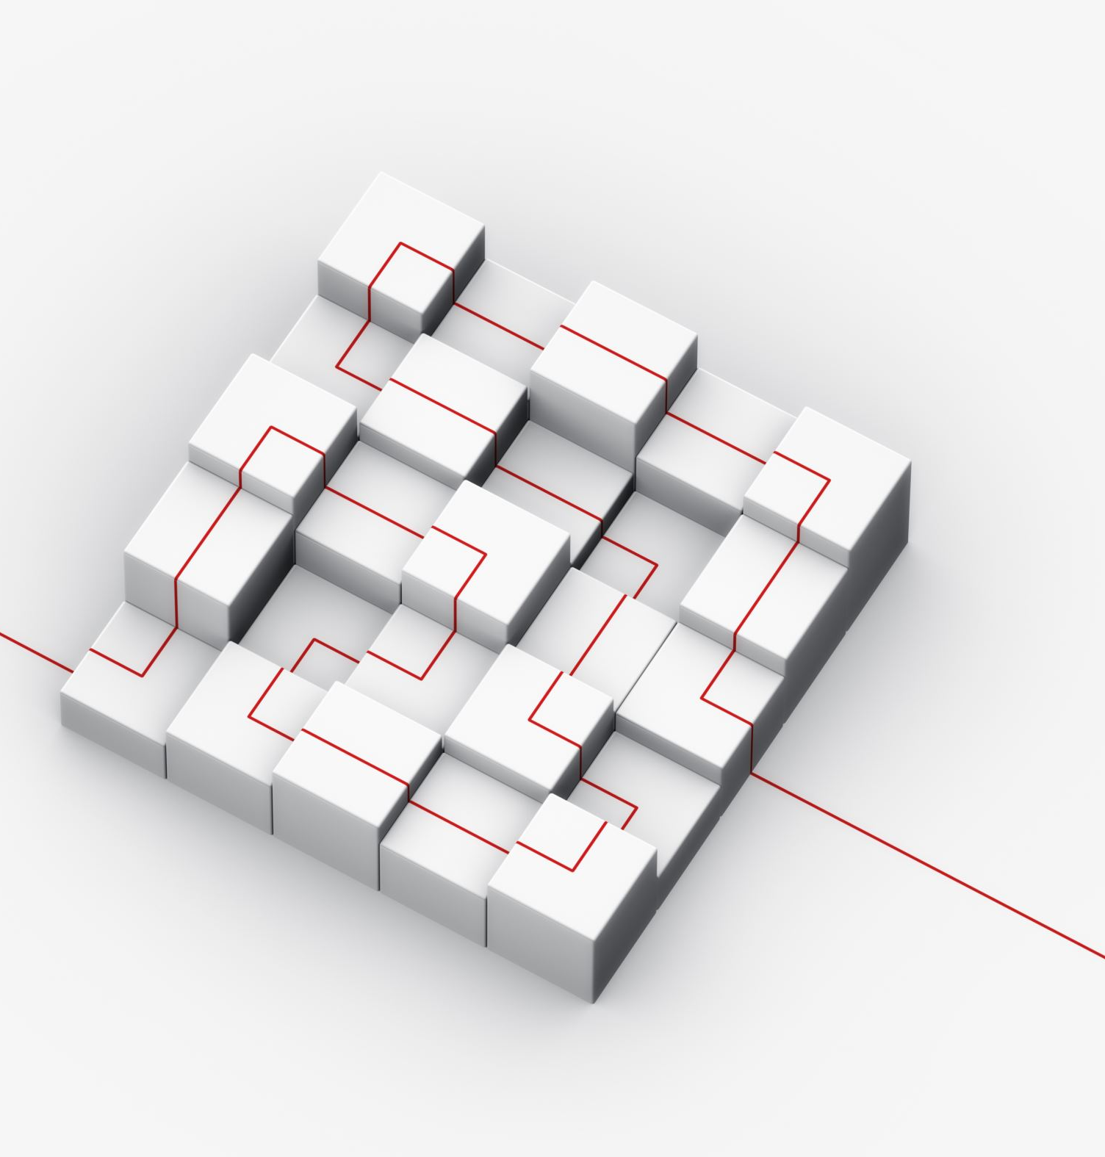
Progress
Initial setup of applications like JIRA, GitHub, and WhatsApp which greatly aid our project.
Create UI designs for all the web pages.
Set up backend environment and dependencies.
Initial phase of frontend development.
Created SCMP, SPMP and SRS.

Slide 11
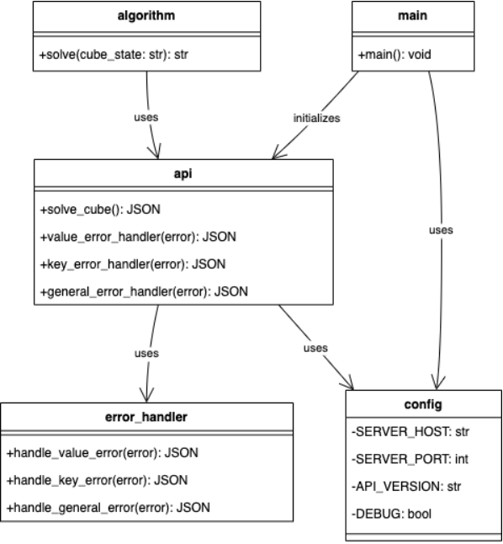
Data Diagram

Slide 12

Upcoming project deadlines
Integrate front-end with back-end, finish hint function, random scramble and reset function (10/31)
Finish login, register, change password, forget password and log out function (11/7)
Finish profile page and profile edit functions (11/14)
Finish progress tracking page (11/21)
Finish rules and regulations page (11/28)

Slide 13
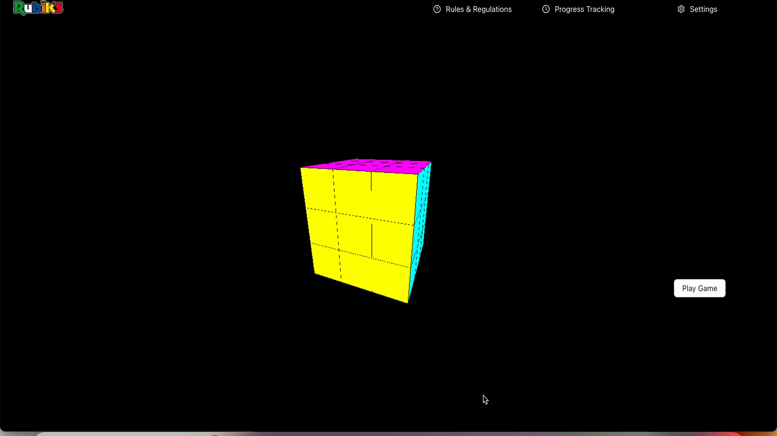
Demo Video
Link to Demo : https://drive.google.com/file/d/1mdVuGVvHrdRBDi7WhKaCKhkHR23v6Tcp/view?usp=sharing

Slide 14
Possible areas of improvements
Use better strategies to improve communications within the team members.
Fix a time and day for weekly meetings to avoid any confusion.
Improve collaboration for work-load balance.

Slide 15

Thankyou !

